Slide 1
Edmodo
Log on: www.edmodo.com

Slide 2
About Me
Katrina Wagner
Starting 11th Year Teaching
Pacific Cascade MS
Issaquah School District
6th Grade Advanced Humanities
BA Elementary Education – Pacific Lutheran
Masters in Literacy from Seattle Pacific
Specialty Endorsement in Gifted and Talented from Whitworth
Leads PD classes for Issaquah School District for middle school teachers; Presented at the NAGC 2014 Convention; Presented at Whitworth Institute 2014
Adjunct Professor: Whitworth University (Summer ‘15)
Summer – Summer Institute for the Gifted (2 years)
Princeton University Housemaster, Instructor, and Academic Dean

Slide 3
Agenda for Today
What is Edmodo?
Setting up a Student Account
What Students See
Setting up a Teacher Account
Navigating the Homepage
Creating and Managing Student Groups
Inviting students, parents and teachers
Sending Posts and Assignments
Other features
Using Edmodo for data-driven instruction (Snapshot)
Parent Accounts
Engaging with Global Communities
Personalizing and Differentiating Learning

Slide 4
What is EDMODO?
Three Pronged
Global Network
35,000,000 users around the world
Connects individuals – not just students
Resources, teachers, parents, administrators, etc.
Professional Development
Online courses
School and District Networks
Private Classroom Networks
Digital Citizenship
Blended and Personalized learning environment

Slide 5
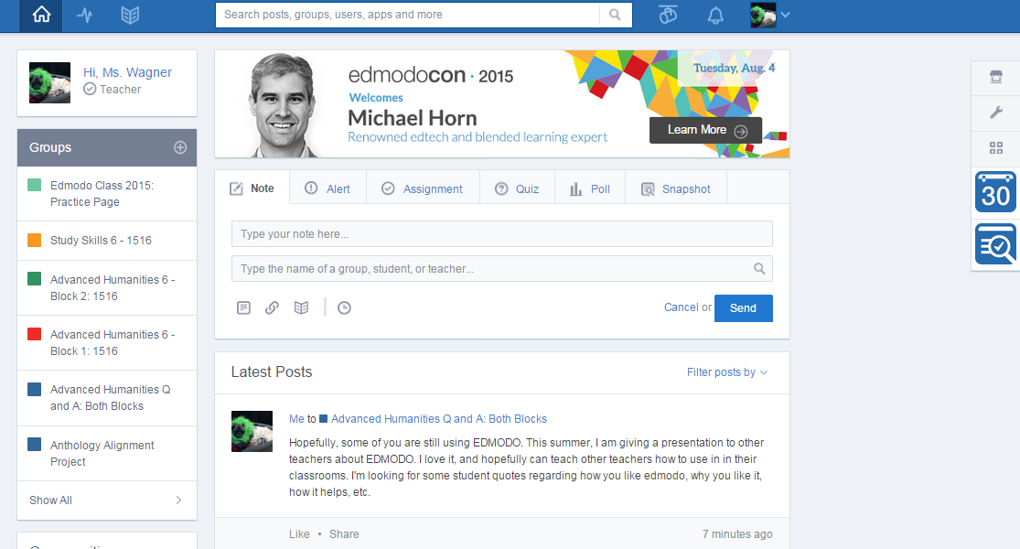
Overview of a Teacher Homepage
Library offers unlimited storage
Calendar, planner, and other apps avaliable
Assignments can be posted, submitted, and graded online.
Collaborative space for discussion and sharing of links.
Private Groups for different classes, clubs, small groups, etc.
Notes:
Integration with Google Docs
A host of educational apps
Single sign on – then access to many apps.

Slide 6
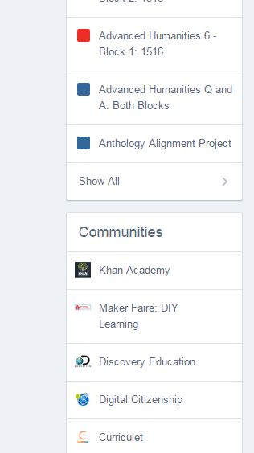
Professional Learning Communities and Resources
Teachers join communities to connect with other teachers around the world on various subjects.
Global
Publisher
School/District

Slide 7
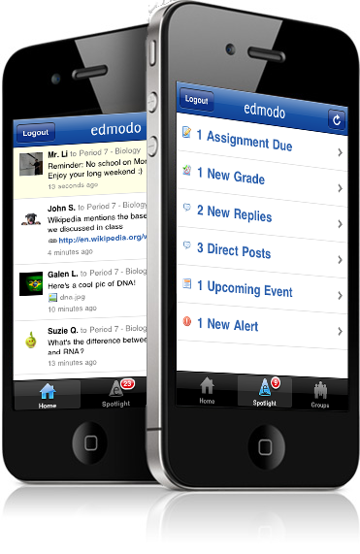
Mobile Anytime, Anywhere Access
Android and apple platforms
https://blog.edmodo.com/wp-content/uploads/2010/06/edmodo-iphone-app.png

Slide 8
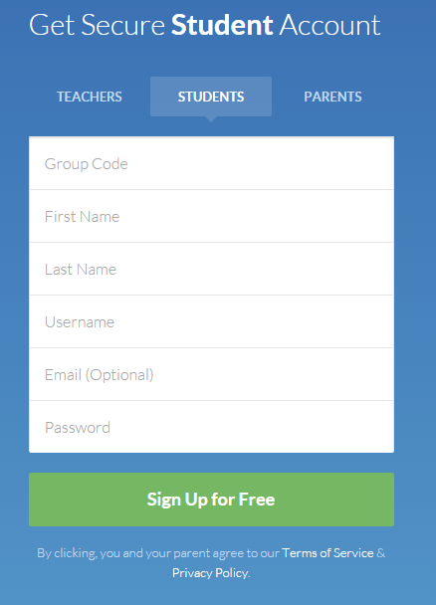
Setting up a Student Account
www.edmodo.com
Any educator creates a “Student Account”
Join the test class: CODE = s8x34t

Slide 9
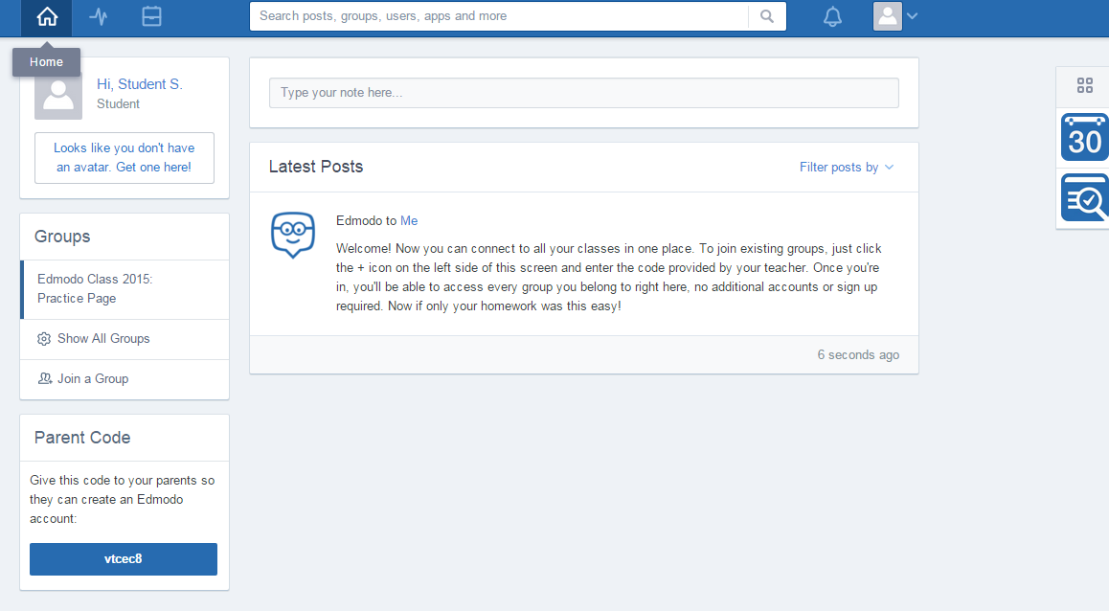
Student Homepage
Features on the Student Homepage:
Backpack (Teacher version called the library)
Parent Code
Groups
Latest Posts
Calendar
Snapshot
Notes:
Student Account
At the class, have participants join the EDMODO test class!
If the student already had an account, they would go to the “Groups” section and “Join a group” and add the new code.
In theory, students could have one account with ALL their classes in one place (with calendars, messages, etc.)

Slide 10
Sending Posts/Notes: Students
Can send to…
The entire group
A small group they are assigned to
The teacher
Students cannot privately communicate to other students
Parent accounts see all messages their child sends
Can also attach a resource (document, link, embed code, folder)
Notes:
The most basic feature of EDMODO!
My Test Student Account:
Studentsampleissaquah2015
Pcms2015
Bring up on the computer and review what students would see
Backpack
Snapshot
Profile/Avatar
Parent Codes
Posting/Replying
While participants have their student accounts up, practice:
Seeing what an assignment looks like
Seeing what a post looks like
Seeing what their calendar looks like
Turning in an assignment
Give them a few minutes to play around

Slide 11
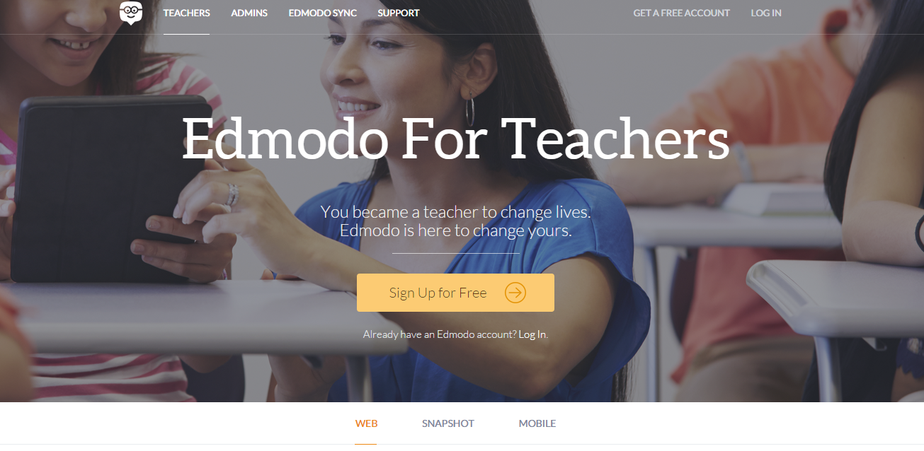
Setting up a Teacher Account
Any educator creates a “Teacher Account”

Slide 12
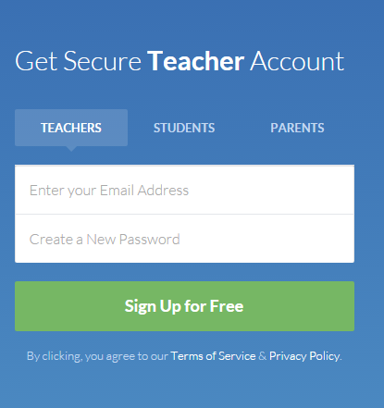
Setting up a Teacher Account
Create an account by entering an:
Email address
Password
Sign-up!

Slide 13
Navigating the Homepage
Whenever you navigate away from the homepage, click the “home” icon to return to this page.

Slide 14
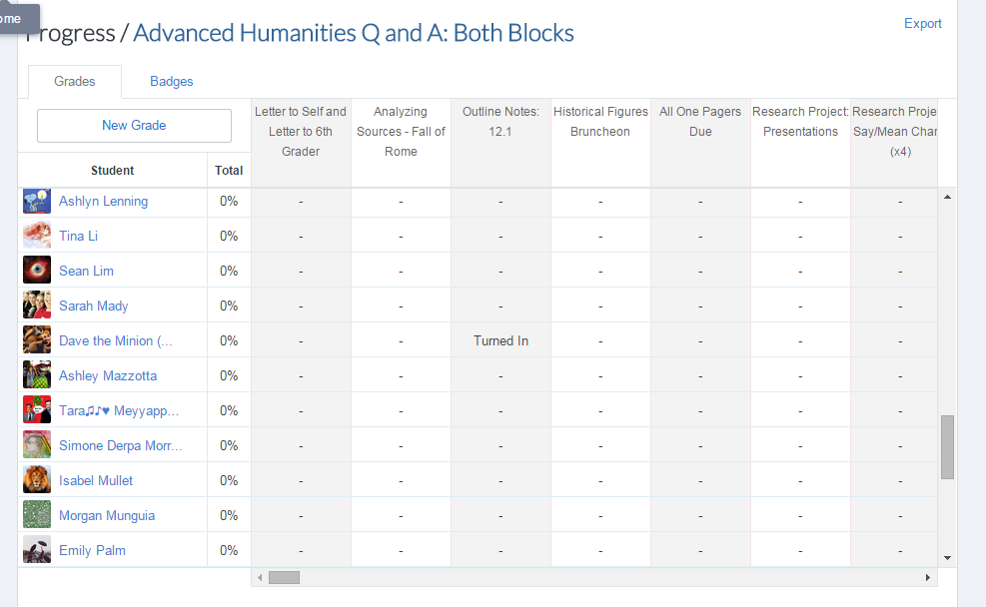
Navigating the Homepage
Progress
See students, and if assignments are turned in

Slide 15
Navigating the Homepage
The Library
Upload resources (files up to 100MB)
Embed links to websites
Once in the library; can create folders and share the folders with students or other teacher groups.
Notes:
Upload resources (files up to 100MB)
Embed links to websites
Once in the library; can create folders and share the folders with students or other teacher groups.

Slide 16
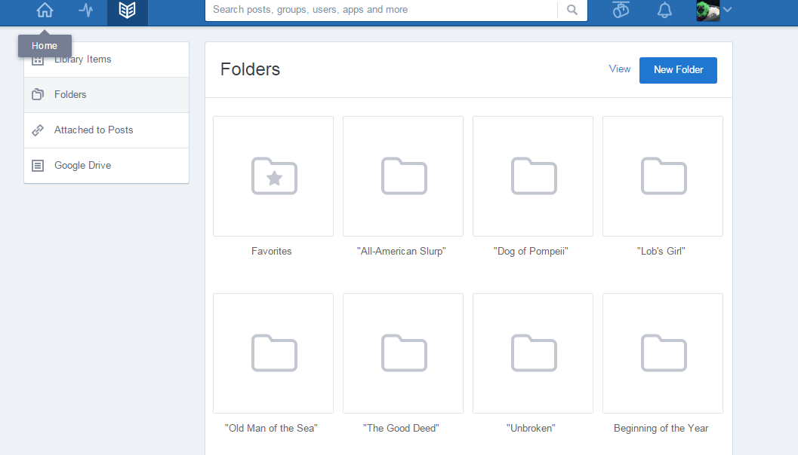

Slide 17
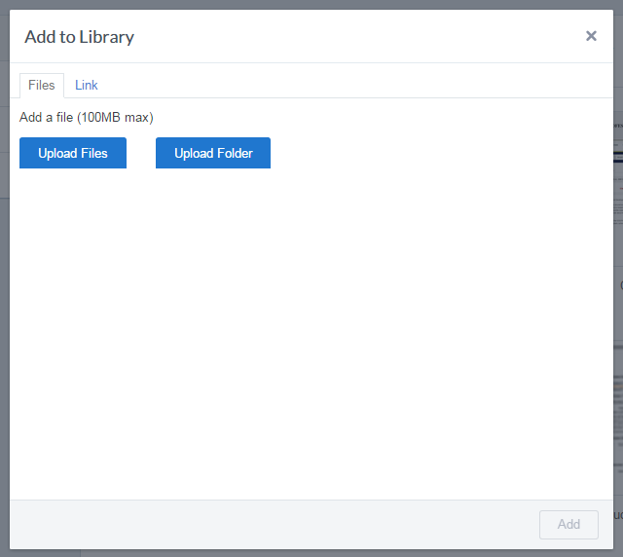

Slide 18
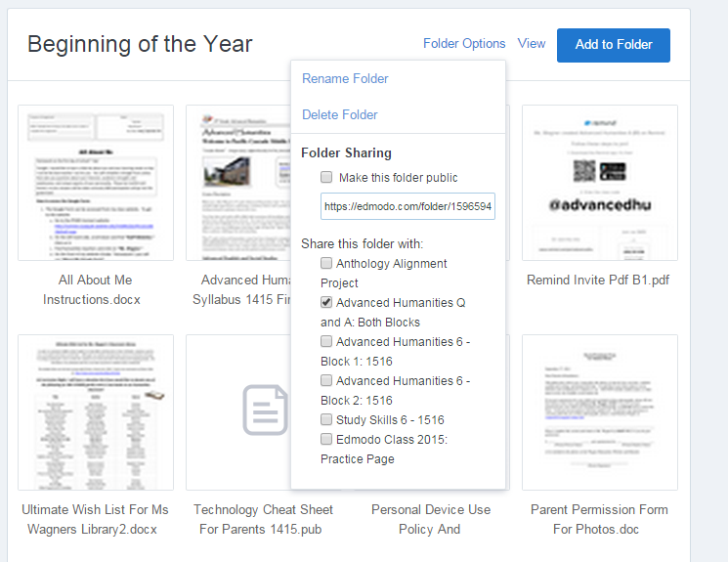

Slide 19
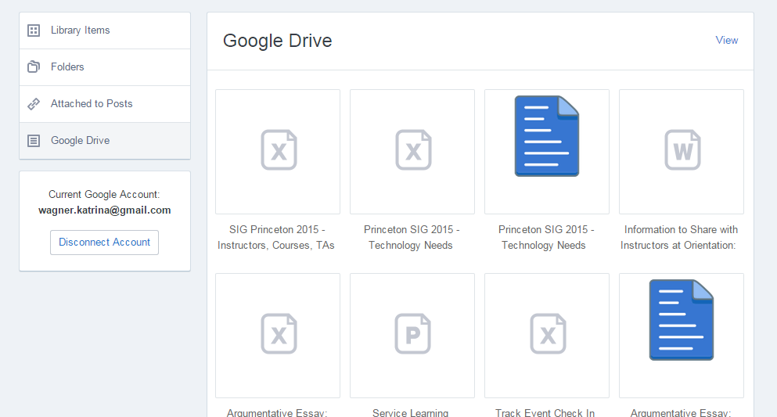
Notes:
Can also connect your Google Drive Account to Edmodo!

Slide 20
Navigating the Homepage
Search Bar

Slide 21
Navigating the Homepage
Spotlight Beta
Edmodo’s “Teacher’s Pay Teachers”

Slide 22
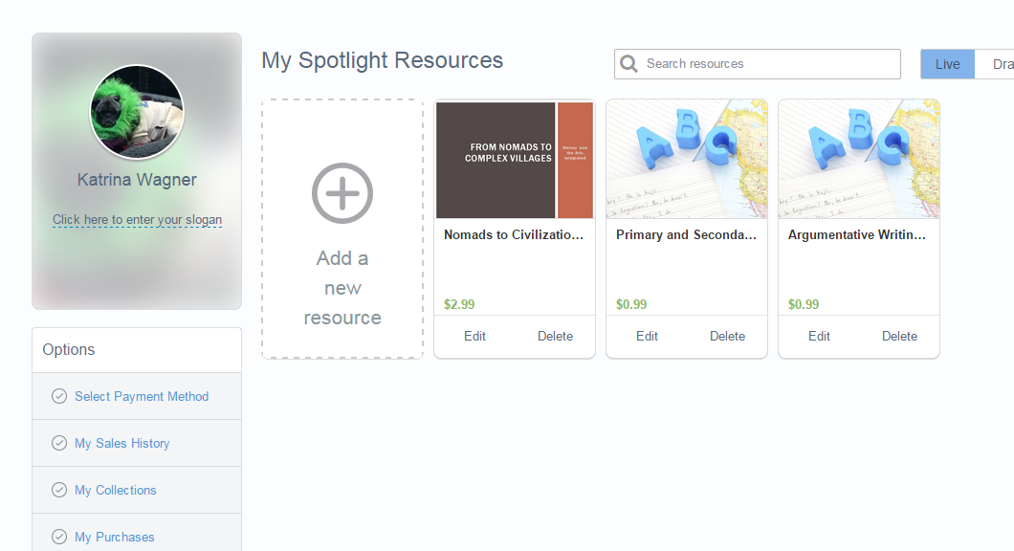

Slide 23
Navigating the Homepage
Notifications
This will let you know when students post, turn in assignments, etc.

Slide 24
Navigating the Homepage
Profile and Settings

Slide 25
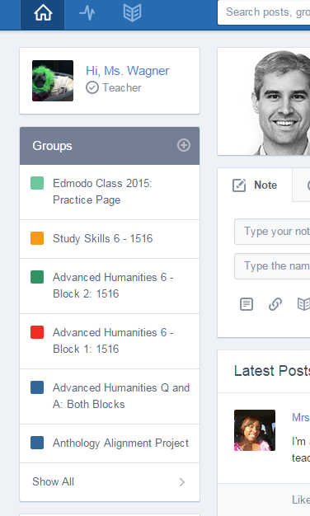
Creating and Managing Groups
Under groups:
List of groups you (or students) have been invited to
Groups that you have created
Using the + sign next to “Groups”, teachers can add or join groups
Students can only join groups

Slide 26
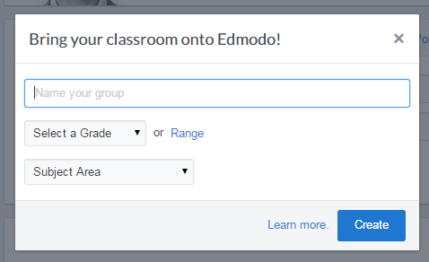
Creating and Managing Groups
Give your group a:
Name
Subject Area
Grade
Once you have a group created, you can invite students in two ways:
URL Link
Code

Slide 27
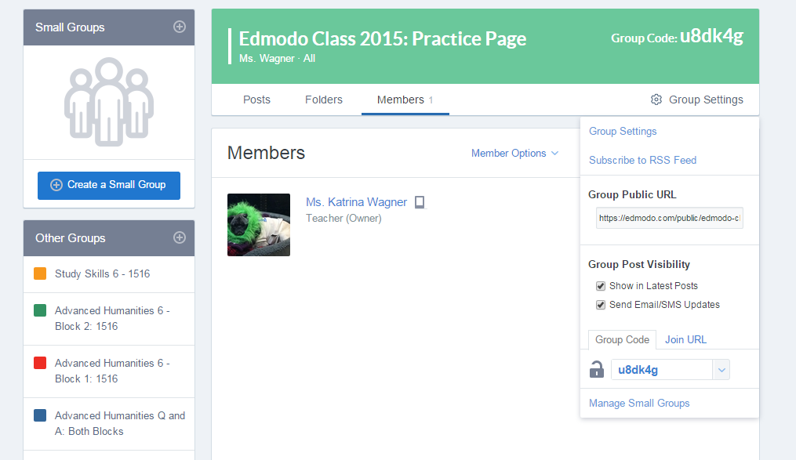
Notes:
I usually just give students the code.

Slide 28
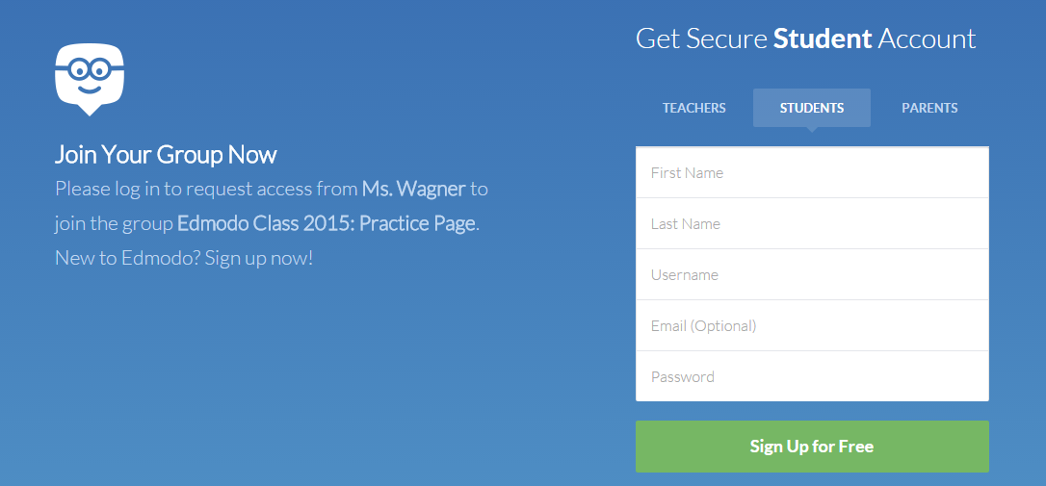
Using the Link
Student accounts do not require email addresses
Requires very little personal information of students
Safe for use of K-12 students
To be extra safe, I always require parent permission
Notes:
If you choose to share the link, students will be taken to a page that looks like this. They will create an account on this page.
When using the link, you will approve users before they have access.
For students
Student accounts do not require email addresses
Requires very little personal information of students
Safe for use of K-12 students
To be extra safe, I always require parent permission
I’ve given you a sample parent permission slip, and can send an e-mail to you! Once students have turned this in, they are allowed to create an account.
If students already have accounts (from another class), don’t have them create a new one! They will just add your class.

Slide 29
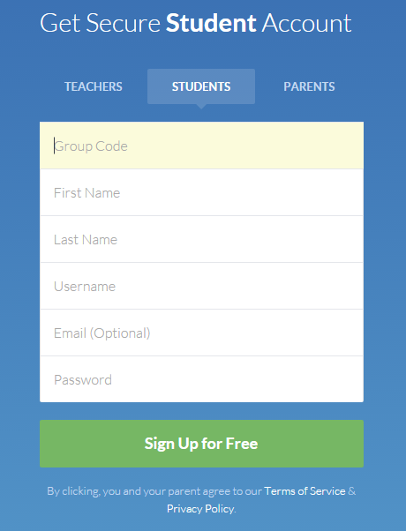
Using the Code
Commonly used when setting up student accounts in person
This is like giving someone the key to your locked door.
Notes:
This is used most often when teachers are signing students up in person (class goes to the lab).
I usually have a “Tech Day” where students set up their Edmodo accounts at school with me; if permission slips are turned in.
Because this gives students instant access, it should never be posted in a public place
The code can later be reset as well!

Slide 30
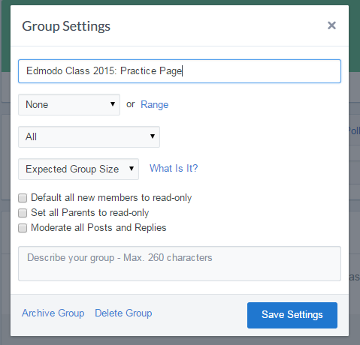
Group Settings
Groups can be archived at the end of the school year.
Very important for many school districts!
No one can post any more
Notes:
This is used most often when teachers are signing students up in person (class goes to the lab).
I usually have a “Tech Day” where students set up their Edmodo accounts at school with me; if permission slips are turned in.
Because this gives students instant access, it should never be posted in a public place
The code can later be reset as well!
Can default all new members to read-only
Can set all parents to read-only
Can moderate all posts and replies
I choose not to do this, because it would be very labor intensive. I deal with inappropriate behavior as it happens.
Some teachers start here and then scaffold away.
Can delete and archive groups

Slide 31
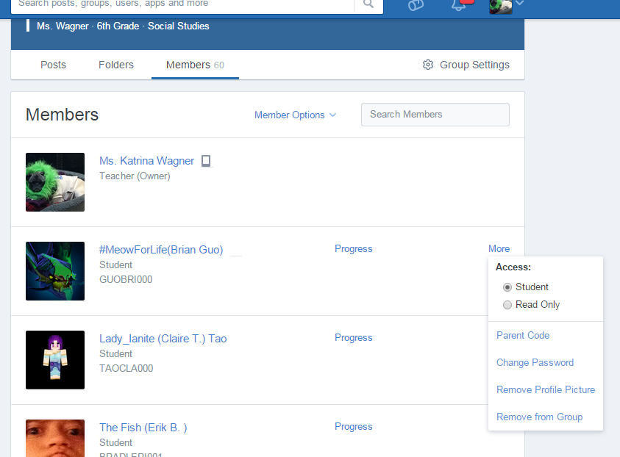
Managing Student Accounts
See their Username
Read Only
Parent Code
Change Password
Remove Profile Picture
Remove from Group
Progress
Can delete and edit student posts
Notes:
See their username
Very helpful when they forget it!
Read Only
For students who may not be able to handle posting responsibly.
See everything, but won’t be able to post
Parent Code
Change Password
When they forget them
Remove Profile Picture
Remove from Group
Progress

Slide 32
Sending Posts/Notes: Teachers
Can send to…
Individual students
Classes of students
Small groups of students
Other teachers with Edmodo
Can also attach a resource (document, link, embed code, folder)
Can schedule posts to show up immediately or on a certain day/time
Students/teachers can then reply – COLLABORATIVE DISCUSSIONS!
Notes:
The most basic feature of EDMODO!

Slide 33
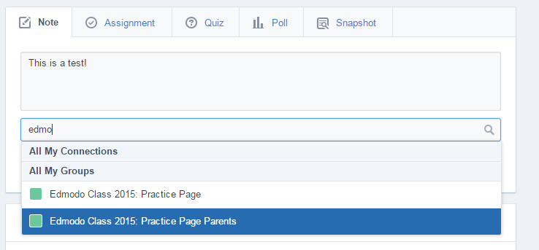
Notes:
During this point online, walk them through…
Adding a link, document or folder
Sending to different groups
Scheduling a message
As an example, attach a document and send to the test group!

Slide 34
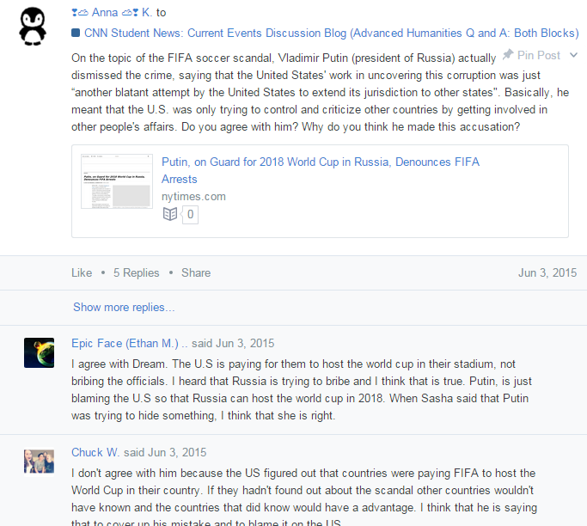
Notes:
Walk them through how I have used Edmodo for blogging about current events issues.
Students start asking the questions.
Creative thinking, problem solving, preparing them for online college classes

Slide 35
Creating and Sending Assignments
Can send to…
Individual students
Classes of students
Small groups of students
Write a description of the assignment
Assign a due date (which will then show up in the calendar)
Attach a video, document, or link to use for the assignment
Attach other resources that will help them with an assignment
Could be used to go paperless, for flipped classrooms, or provide extras for students who may lose their papers easily.
Students can reply and ask questions; support each other (creates a community of learning)
Students can also “Turn In” assignments via Edmodo.
Notes:
Walk though this process online!
Post an assignment from my teacher account that teachers can see.

Slide 36
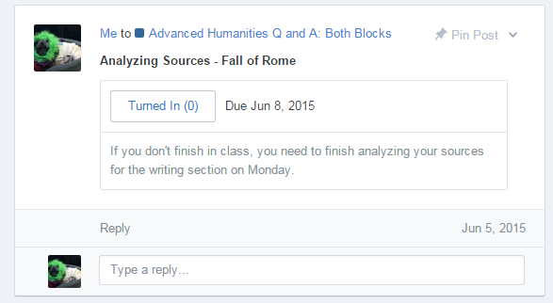

Slide 37
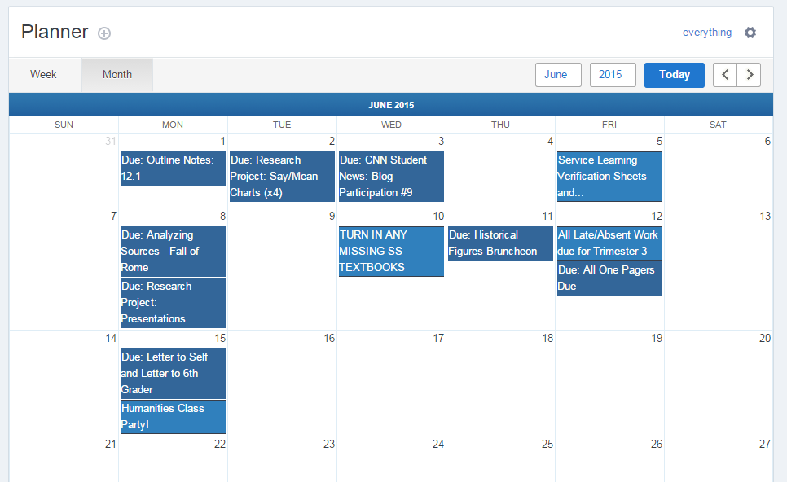
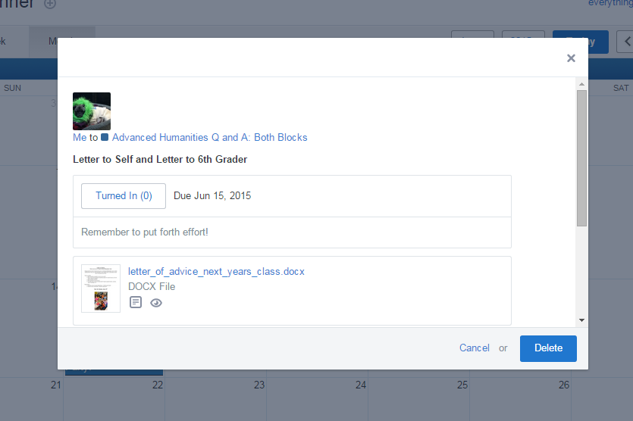

Slide 38
Other Features: Polls, Badges and Quizzes
Polls:
Anonymous (but kids could hit reply and give context to their vote)
Ask questions to see student understanding, attitudes, etc.
Pre-reading, pre-assessment, Post-reading
Get a quick idea of the pulse of the class
Badges:
Teacher can decide what the badges are
Can be awarded on student profiles
Positive recognition
Quizzes:
Add your own questions
Can get a question breakdown
Can grade the quizzes for you (formative uses)
Can also be printed, if necessary

Slide 39
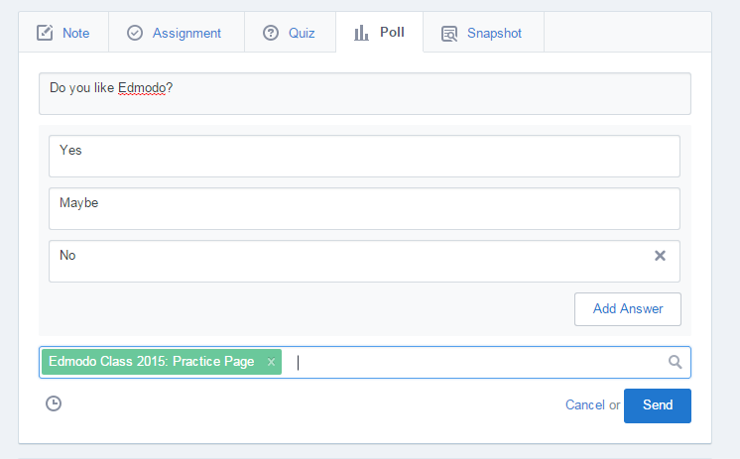
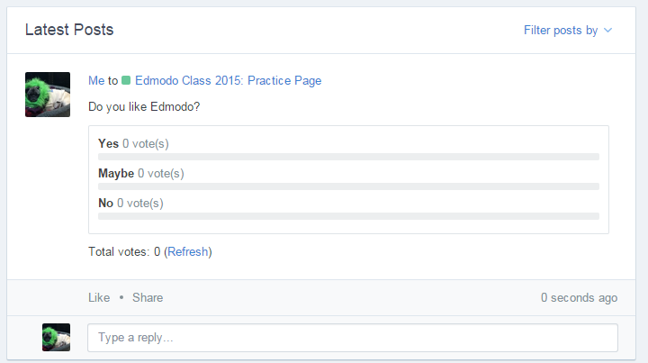
Polls

Slide 40
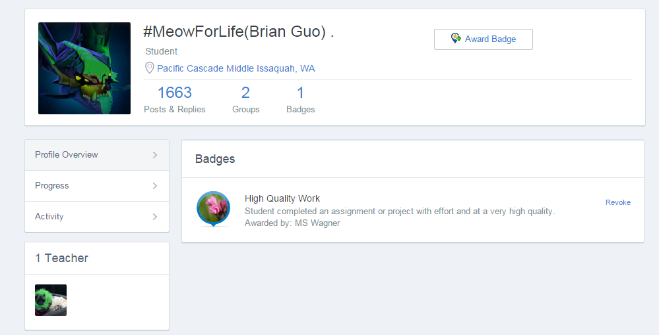
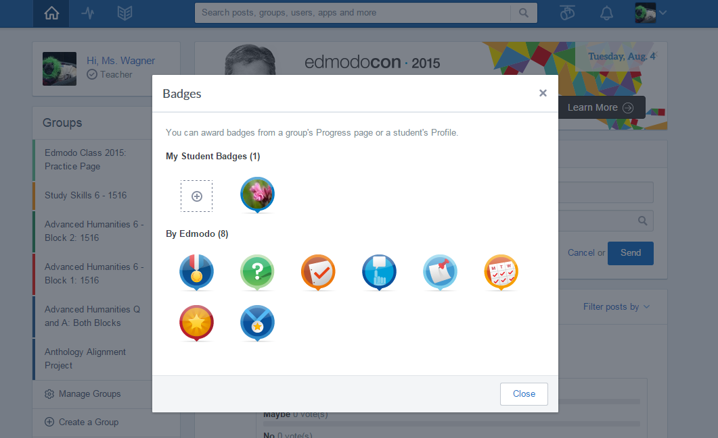
Badges

Slide 41
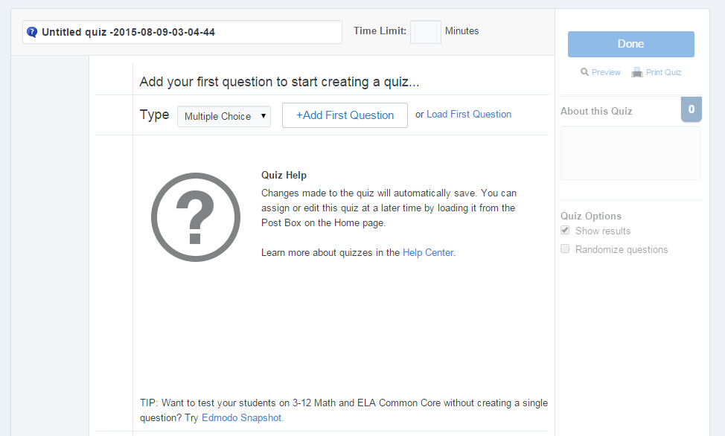
Quizzes

Slide 42
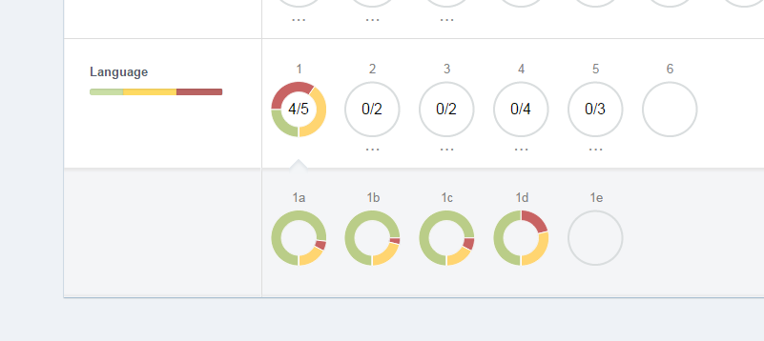
Using Snapshot
What is it?
Common Core aligned, micro-assessment tool
Formative assessment for learning
Details:
Every standard; 4 questions
Currently: 3-12
Math and ELA
Working on adding state standards and K-2
Varies the questions; not exactly the same for each student
Notes:
The most basic feature of EDMODO!

Slide 43
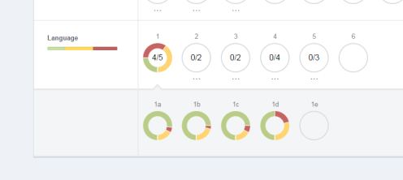
Using Snapshot
What do students see?
In kid-friendly terms, what they mastered and what they need to work on
What do teachers see?
Sort by proficency or last name
Click on any standard to see what they were asked and what they answered
Can see every student on their own page; can be printed
Can see a breakdown of where students are for each standard.
Can tier lessons or differentiate based on this feedback
Notes:
The most basic feature of EDMODO!

Slide 44
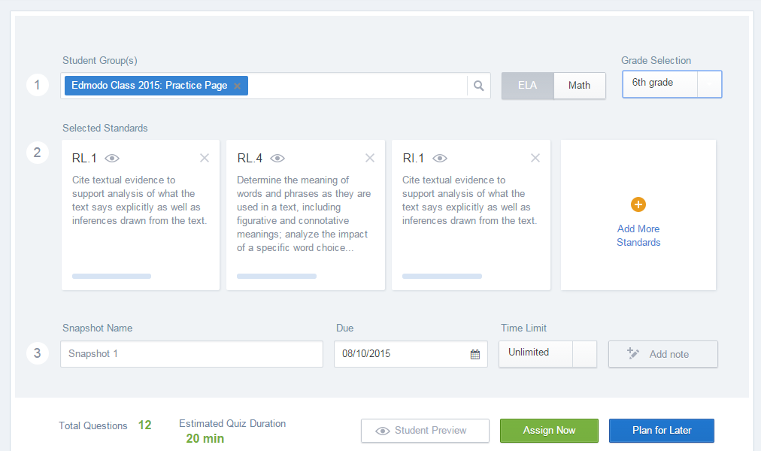

Slide 45
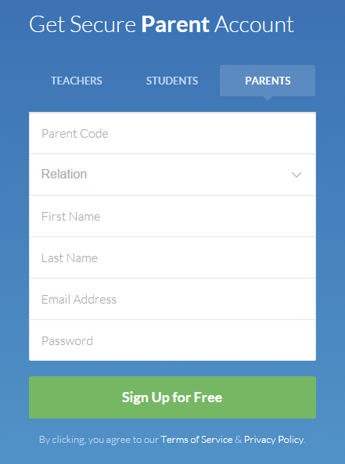
Parent Accounts
Parent Accounts:
They are a “fly on the wall”
Cannot communicate
See posts that the teacher sends to parents
Can view student/teacher interactions (only their child’s)
Can see the calendar, child’s profile, get notifications
Notes:
Parent Accounts
Parents can insert their students’ parent code and sign up.
Teachers always have access to parent codes as well and can sign parents up as well!
Get a birds eye view; not members of the group (just attached to the student)
Can see posts that teachers choose to send to parents; can see child’s profile and progress; can see any grades
Parents are able to see the activity between teacher and child; keep in touch. Parents cannot communicate – fly on the wall.
Can get notifications outside of the account; app

Slide 46
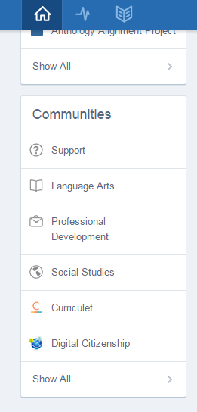
Engaging with Global Communities
Teachers share resources, questions/answers
Add with the click of a button
Connecting students for global projects/pen pals

Slide 47
Personalizing and Differentiating Learning with EDMODO
In the News:
Create a Current Events Group and allow students to post articles and blogs that are relevant to classroom curriculum. Review posts at your morning meetings.
Cultural Exchange:
Create small groups to study different aspects of Greek culture (or any other topic). Students can focus on one aspect and then teach all the other students about it.
Punctuation and Grammar:
Students are always developing the skill of always capitalizing and punctuating. Show the posts, or other incorrect paragraphs, and go in and edit them with the class. It is a great way to do D.O.L with practical material!
Notes:
The most basic feature of EDMODO!

Slide 48
Personalizing and Differentiating Learning with EDMODO
Peer Reviews & Critiques:
Place students in small groups and have them post their work to their group for peer review and feedback.
Role Playing
Help students understand key historical and literacy events by reenacting them through role playing activities in Edmodo.
Writing Projects:
Enable students to tap into individualism and build self-esteem by sharing their writing projects with each other in Edmodo.
Notes:
The most basic feature of EDMODO!

Slide 49
Other Ideas for Edmodo Use
Playground:
Kids are kids and sometimes they just have something funny that they are dying to share. Create a “Playground” group where students have free reign to post whatever they want (with guidelines for appropriate use of course — encourage expression and creativity, but reinforce the need for boundaries and appropriate behavior).
Announcements and Special Events:
Celebrate milestones by creating a classroom group that highlights birthdays, college acceptance, sporting events, and other milestones in students lives.
Build Digital Citizenship Skills:
Enforce online etiquette guidelines for students when using Edmodo to help them build digital citizenship skills.
Notes:
The most basic feature of EDMODO!

Slide 50
Other Ideas for Edmodo Use
Book Clubs:
Organize a book group in Edmodo to encourage students to read and discuss novels with each other.
Sub-Hub
Use Edmodo to communicate with your students when you’re out of the classroom, or provide updates to students who are absent from class.
School Clubs
If you’re part of a school club or sports team, create an Edmodo group to coordinate meets, practices and games, as well as post results.
Notes:
The most basic feature of EDMODO!

