Slide 1

Differentiation Strategies to Engage Underperforming Students in Middle School and Highly Capable Classes

Slide 2

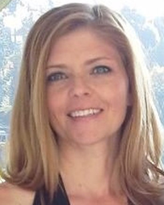
About Us
Katrina Wagner
  Starting 11th Year Teaching
  Pacific Cascade MS
    Issaquah School District
    6th Grade Advanced Humanities
  BA Elementary Education – Pacific Lutheran
  Masters in Literacy from Seattle Pacific
  Specialty Endorsement in Gifted and Talented from Whitworth
  Leads PD classes for Issaquah School District for middle school teachers; Presented at the NAGC 2014 Convention; Presented at Whitworth Institute 2014
  Adjunct Professor: Whitworth University (Summer ‘15)
  Summer – Summer Institute for the Gifted (2 years)
    Princeton University Housemaster, Instructor, and Academic Dean
Kim Bailey
  Starting My 11th Year Teaching
  Pacific Cascade MS
    Issaquah School District
    Math Teacher
  Currently working towards a Masters in Education with an emphasis in S.T.E.A.M from the University of San Diego
  National Boards Certified in EA Math
  Presenter at the November, 2014 NAGC (National Association for Gifted Children) Conference in Baltimore, MD
  Academic Dean at the Summer Institute for the Gifted (SIG) Summer 2015

Slide 3

Video
Notes:
http://www.ted.com/talks/ken_robinson_changing_education_paradigms

Slide 4


“Lack of attention”
“Lazy”
“Low standards”
giftedchallenges.blogspot.com
www.wisegeek.com
“Incomplete assignments”
“unmotivated”

Slide 5
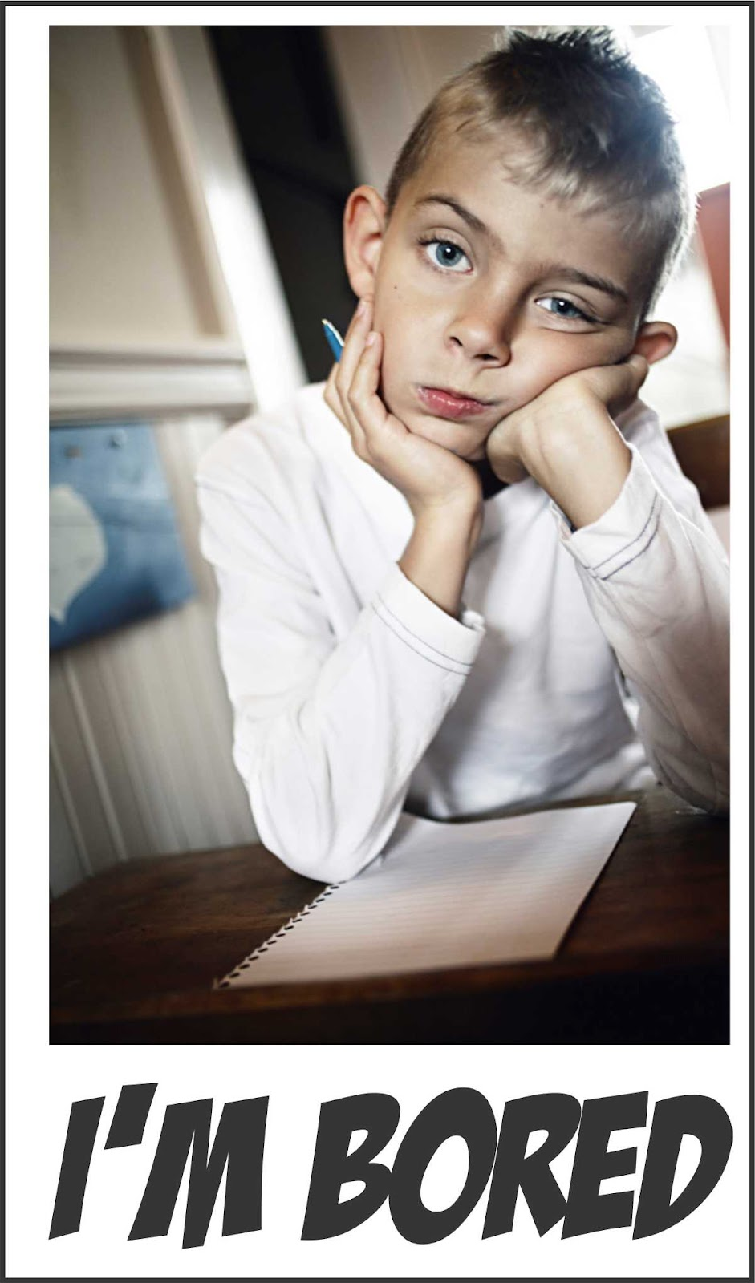
“Underachievers sit in virtually every classroom and live in many families. They waste educational resources, try the patience of even the best teachers, manipulate their families toward chaos, and destroy their own confidence and sense of personal control.” (Rimm)

Slide 6
Underachievement Syndrome
Rimm, 2008
NO genetic, neurological or biological explanation for inadequate school performance by all capable children
Includes all students who do not have a documented need for accommodations or modifications
NOT one particular cause
These children have learned to underachieve
Underachievers…
  Usually begin as bright and verbal preschoolers
  Have an either gradual or dramatic change in their enthusiasm for learning
  Have percentile scores that decline steadily as they enter underachievement mode

Slide 7
Characteristics of Kids with Underachievement Syndrome
Rimm, 2008
Disorganized
Dawdle
Forget homework
Lose assignments or books
Day dream or talk to much to others
Doesn’t listen
Considers themselves to have studied after one look at the material
Slow and perfectionistic
  “If I finish the work, it will be wrong anyways.”
Careless errors
Lonely and withdrawn
Cry, whine and complain
Bossy; lose tempers easily
Describe school as boring or irrelevant

Slide 8
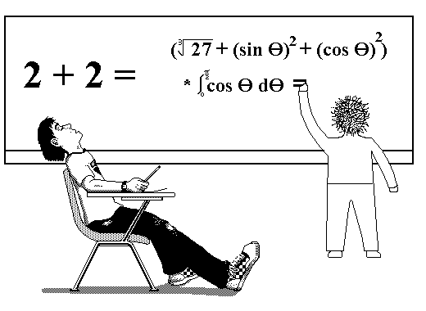
Characteristics of Kids with Underachievement Syndrome
Rimm, 2008
Creative underachievers may have many unusual ideas, but never bring them to fruition
Hyper focused on one project
Some never read; others escape life by reading all the time
Don’t believe they can achieve their goals
They don’t understand what “work” actually means
They deny themselves the opportunity to build confidence
ALL IN COMMON: Unconsciously manipulative
  Parent against parent
  Teacher against parent
  Parent against teacher
  Friend against friend
www.rollingsmiddle.com

Slide 9

Underachievers say…
Rimm, 2008
“I get poor grades because I have horrible teachers!”
“Who wants to be a geek anyways.”
“The test scores must be wrong; I’m not that smart.”
“I’d rather not do it at all than do it less than perfectly.”
“If my mother would only let me work on the computer for as long as I wanted, I could eventually earn a six-figure salary.”
www.ten57mag.com

Slide 10
Gifted Underachievement
Rimm, 2008
“It has been reported that 20% of high school dropouts are gifted.”
Gifted underachiever vs Low achiever
  Ability to score high on standardized achievement tests
  Discrepancy between ability and achievement
  Sylvia Rimm’s Definition
    “Underachievement is a discrepancy between a child’s school performance and some index of the child's ability. If children are not working to their ability in school, they are underachieving” (Hoover-Schultz).

Slide 11

Why Does it Matter?
Gifted children are the largest group of underachievers in education
  At least 63% of students with an IQ of 130 or above are seriously underachieving and many of these students have a record of truancy.
Much of the educational community believes that gifted kids can succeed on their own and don’t need any special nurturing; little is done to meet their needs
  They are among the most poorly served in the school population.

Slide 12

Why Does it Matter?
In the United States, there is no federal mandate for programs or services for gifted learners in the public schools.
“Only 9 of 50 states require IEPs for the gifted and talented students they serve” (Clark).
“This situation leads to unnecessary loss of ability, especially among girls and minority students, and regression toward a more average ability level…” (Clark).
“An environment that is confining, solitary, or lacking in challenges limits the growth of the brain…” (Clark).

Slide 13
“Though more underachievers pervade the school system than all of the special education students combined, there are virtually no special services available to help them. This lack of programs for underachievers is at least partially due to our society’s tendency to label the underachiever as being unresponsive and even lazy” (Hishinuma)

Slide 14

Why Gifted Students can be Underachievers
Hoover-Schultz, (2005)
Environmental Factors
  The School
    Anti-intellectual school atmosphere
    Inflexible requirements for graduation
    “Hidden Underachievers” – The educational system is not set up to recognize their talents
    “Meaningful learning engages gifted children, and lack of challenge is one of the reasons gifted children are often late turning in their homework” (Strip and Hirsch).
  Student’s Peer Group
    “Underachieving students often report peer influence as the single most important force blocking their achievement.”
    Anti-academic peer groups can exert pressure on gifted students

Slide 15

Why Gifted Students can be Underachievers
Why Gifted Students can be Underachievers
Power Struggles with adults
  Child, feeling pressure to measure up, can openly rebel
  This can also take the form of underachievement
    Student realizes they can’t “measure up” and gives up trying
    Misguided way of taking control of his/her own life

Slide 16
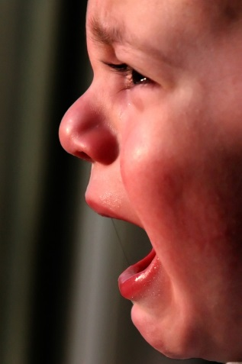
Why Gifted Students can be Underachievers
Why Gifted Students can be Underachievers
Personal/Family Factors
  Unfavorable coping skills or learning styles
    Low levels of self-confidence
    An inability to persevere
    A lack of goals
    Feelings of inferiority
  Poor family relationships and inconsistent standards
  Parents of underachieving students may not have the skills to support their gifted children
  Cultural/language barriers

Slide 17

Why Gifted Students can be Underachievers
Why Gifted Students can be Underachievers
Boredom
  Non-challenging work = no effort needed; no learned perseverance
  Impatience with classmates who aren’t performing at their levels
  Overconfidence and/or frustration can have a negative effect on their success
  Feel that their teachers are “stupid” and are less motivated to listen
  “Some experts theorize that nearly one-quarter to one-half of gifted children’s time is spent waiting for the other students to catch up” (Strip and Hirsch).

Slide 18
Why Gifted Students can be Underachievers
Why Gifted Students can be Underachievers
Perfectionism
  One of the most pervasive characteristics of gifted children
  A child who has repeatedly failed to measure up to standards (their own, teachers, or parents) will just give up and stop trying
    May refuse to do homework or study for tests

Slide 19

A Different Brain?
fMRI’s (functional brain magnetic resonance imaging) of gifted thinkers, it looks like a ‘brain on fire”
  High metabolic activity
  Brain activity is intense and complex; involves the coordination of diverse visual, spatial, verbal, and sensory areas
  Great organizers of diverse and multimodal information
Positives
  More vivid sensing, increased memory, greater knowledge, more varied associations, greater analytic ability
Drawbacks
  Sensory, emotional, and memory overload; hypersensitivities, personal disorganization, sensory distractibility, “lost in thought,” and metal fatigue

Slide 20
Types of Gifted Underachiever

Slide 21
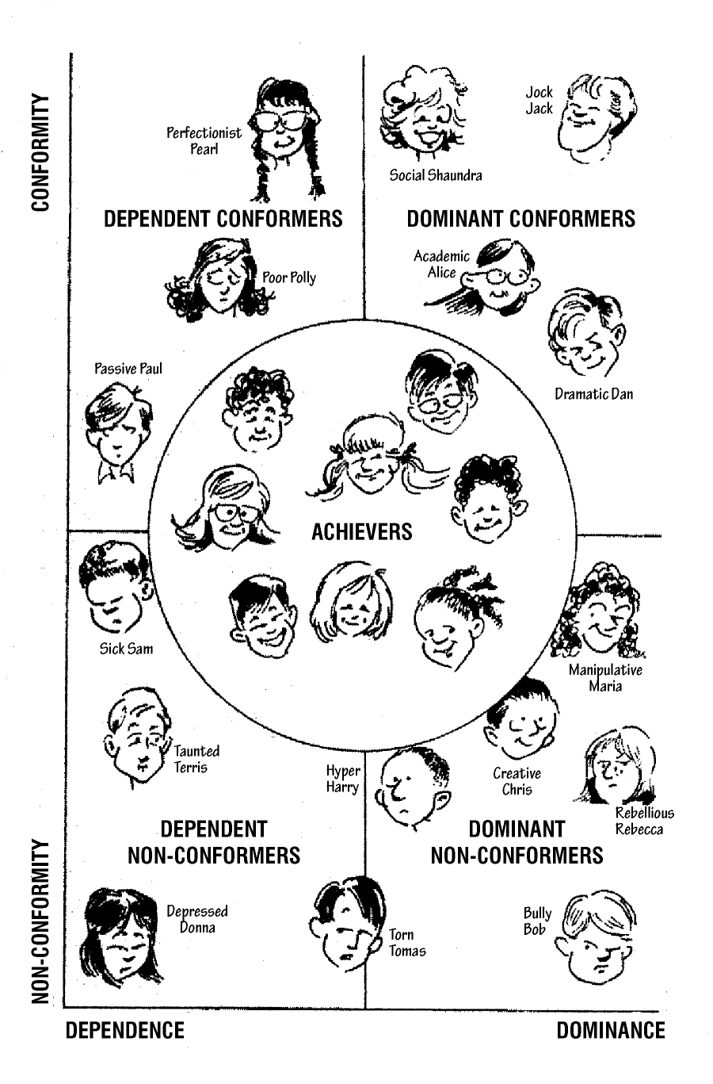

Slide 22
Main Types of Gifted Underachievers
Dependent (Conformer and Non-Conformer)
  Some find that talking about sad feelings is a passive way to control an adult.
  Often lacks organization skills
  Avoid competition/fear of failure
  Often afraid to contribute creative ideas/they are highly critical
  Establish ways to avoid doing homework
  Rarely set realistic goals for themselves
  Overwhelmed with long-term assignments

Slide 23
Main Types of Gifted Underachievers
Main Types of Gifted Underachievers
Dominant Conformers
  They rarely fail courses; do just enough to get by
  Manage to avoid learning to cope with failure by only engaging in activities that they are good at or can win
  They might not become underachievers until later on in school (high school or college)
  They usually live in highly competitive families
  Feel good when they control their activities
  Often have a defensive response to criticism
  Will only show parents work/tests that get an “A.” Parents are probably not seeing anything else.
  They see a lack of praise as criticism

Slide 24
Main Types of Gifted Underachievers
Main Types of Gifted Underachievers
Dominant Non-Conformers
  Most resistant to change
  Often belligerent, cocky, rebellious, hostile, negative, angry, violent
  Feel confident when they are in control
  Feel they don’t have an area of expertise to get attention from
  They are “show-people” and like to have an audience
  They want to be instantly successful.
  Consistently compete with everyone (for them to feel good, others must feel bad)
  Will often try and manipulate adults against each other
  Life for them is boring if they are not busy
  Will blame the pressure they feel on their teachers and parents

Slide 25
Activity: What type are you?
Look at anecdotal notes
Discuss with your group
Determine type of underachiever

Slide 26
“Given an appropriate education, these students [gifted underachievers] can grow up to become leading scientists, mathematicians, artists and writers. Unfortunately, for many of these students, their gifts represent a lost opportunity” (Birdsall and Correa).

Slide 27
Strategies to Re-engage Gifted Underachievers
Strategies for dealing with perfectionism and a growth mindset
  Enrichment for students who demonstrate mastery
  Strategies for cooperative learning
  Options for interest-driven, individualized, higher-level learning
  Strengthened teacher expertise

Slide 28
Strategies for Dealing with Perfectionism and a Growth Mindset
Perfectionism
  Help children realize that setting high standards is admirable, but not meeting standards is not a reason for a loss of self-worth
  Point out that failure can be the best teacher
    Share stories of innovators who are successful BECAUSE they failed
      Beethoven
      Einstein
      Thomas Jefferson
  Help students practice time management
  Help students set goals and prioritize

Slide 29
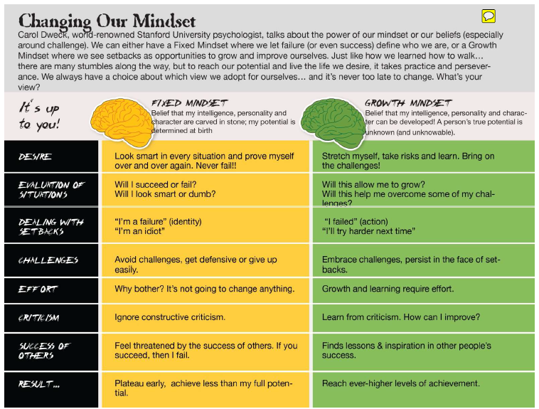

Slide 30
Individualizing Instruction
Assess which students have achieved mastery of unit materials before teaching
  Compacting and providing extension work can offer opportunities for gifted students to explore, use advanced technology, and investigate disciplines outside the traditional curriculum
Gifted middle school students may still need help developing resilience and strategies for using their gifts (Willis).
Middle school may offer their first challenges by encountering information that is difficult
  They may not know how to persevere
  They may think they are no longer smart

Slide 31

Why Cooperative Learning can Fail to Motivate Some Gifted Learners
More efficient to work independently
Struggle with social skills
Do not want the “Smart Kid in the group” stigma
Do not see value in communicating their understanding
Do not want to teach other kids

Slide 32

How to Create a Positive Cooperative Learning Environment for Gifted Learners
Helping students develop a growth mindset through cooperative learning:
Mindful group selection
Thoughtful selection of groups tasks
  Challenge level, length, and final product
Explicitly teaching expectations and the value in cooperative learning
Successful teacher facilitation
  Actively monitoring
  Recording positive group observations
  Require teacher check-ins
  Positive reinforcement of cooperative learning skills
    Sharing observation with the class
    Peer evaluation of positive contributions of each group member

Slide 33
Options for interest-driven, individualized, higher-level learning
Activate their executive functions
  Judgment, critical analysis, prioritizing, organizing, separating fact from opinion, weighing validity, deduction, induction, recognizing relationships
  Allow gifted students to mentally manipulate information
  Increased input, questioning, creative problem solving, analogies, connecting knowledge to real-world possibilities

Slide 34
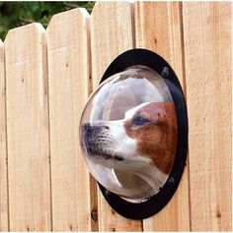
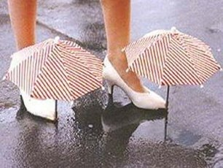
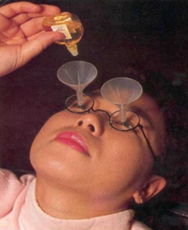
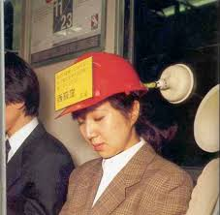
Increase Interest with Creativity
Activities that are outside the norm:
Activities that improve interest, creativity and problem solving
  Trying new things
  Doing something in a new way
  Art based activities
Challenging Assumption- changing your view on things (taking garbage and turning it in to something valuable)
Chindogu Japanese Art- the art of creating “un-useless” inventions (not useless, but not useful)

Slide 35

Straight Ahead – Uphill - Mountainous
Straight-Ahead
  Instructions guide you from start to finish
  All grade-level content, skills, and language
Uphill
  Instructions take you about half-way, then drop you off to see if you can finish
  Mostly grade-level content and skills; language may be slightly above grade-level
Mountainous
  Instructions get you started, but you guide the task for most of the journey
  Content and skills extend beyond the grade-level framework; cognitively demanding diction

Slide 36
“Students feel valued and motivated to achieve when adults listen to them, allow them to explore, give them a voice in planning classroom activities, reward them when they try things that stretch their intellectual limits, and respect their dignity and individuality” (Strip and Hirsch)

Slide 37
Extension Activities
When students document mastery, their first activity should be to engage with that material at a higher level
    It isn’t silent reading time or journal writing time
    Focus on depth and complexity
Think: How can a standard be extended in more challenging ways?
Should not be MOTS (more of the same)!
MOTS almost guarantees:
  Passive withdrawal
  Disruptive, aggressive behavior
  Boredom and frustration
Let them “outside the umbrella” of the classroom activities

Slide 38
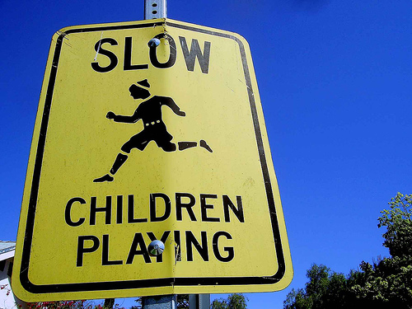


Extension Activities
Examples
      Tic-Tac-Toe Board
      Learning Center/Labs
      Technology Based – Website
      Community Service
Get ideas from…
      Old/current textbooks
      Sharing ideas with team members
      Online Resources
              Learnist – Website

Slide 39

Tic-Tac-Toe Board/Extension Menu
Can be used as extension work, a tiered assignment, or a way to offer choice to gifted students
Options:
    Student choices create a “tic-tac-toe”
    Choose one option that ALL students must do
    Base on skill level, interest, multiple intelligences, etc.
Allows for creativity, and students feel empowered to dictate the direction of the own learning
www.exquisite-minds.com

Slide 40
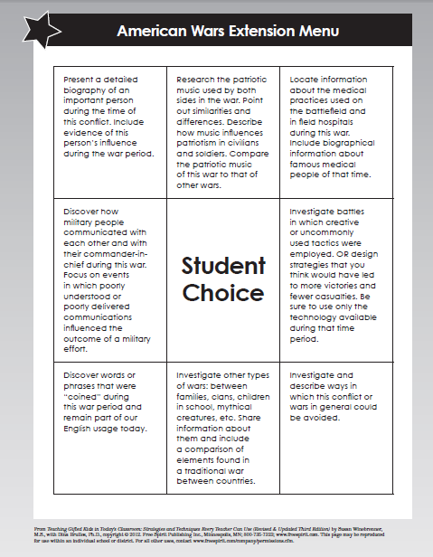
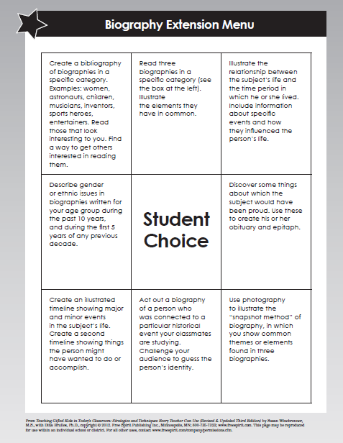

Slide 41
DDM – Digging Deeper Matrix
Provides a tiered system for creating activities at all levels of Bloom’s that are rigorous and complex
Moves all students into advanced levels of thinking, while respecting varying needs for academic difficulty
Levels
  Level 1 (Blue): All students
  Level 2 (Pink): Some students
  Level 3 (Green): Advanced Learners
Could be used…
  Homework provided to all students; small groupings
  Extension Work (the Advanced Options)
  For individuals or small groups
  As a guide for instruction
  Selected activities used during lessons
  As sequential movement
  As an assessment tool for curriculum and instructional purposes
Notes:
DDM:
Remember that the higher level work should not just be more work
All activities should be equally fun, engaging, and interesting

Slide 42
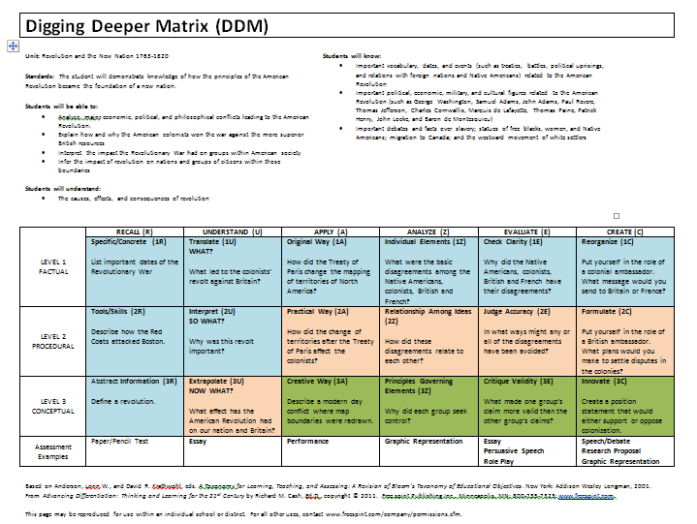

Slide 43
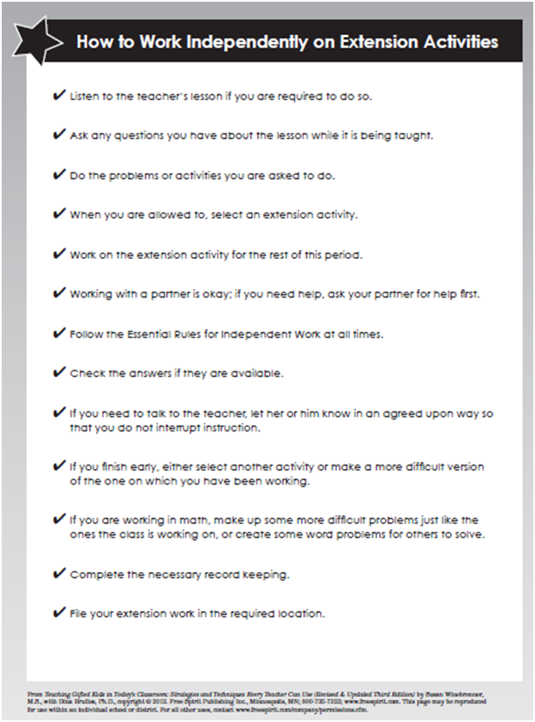
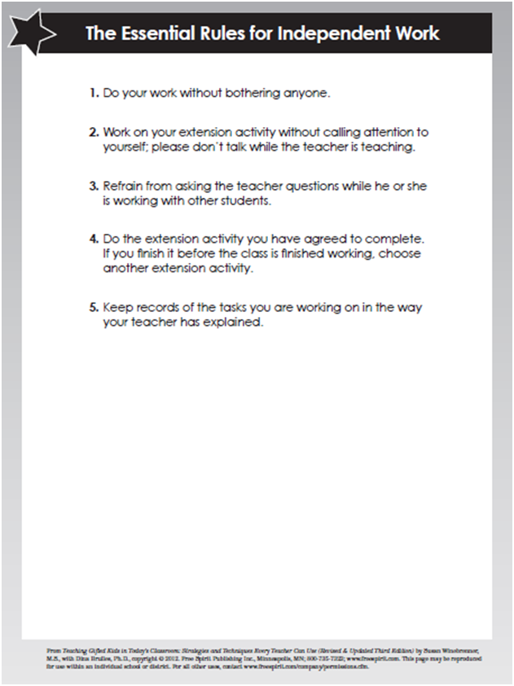
Implementing Extension Activities
Just for gifted? It is beneficial for all students

Slide 44
Grading Extension Work
You don’t – Most of the Time
Grades entered are the ones that document student mastery
      Add comments to the gradebook about extension work
      Monitor all curriculum modifications on the Compacting Form
Compacting Form
      Created by Joseph Renzulli and Linda Smith
      Use a separate one for each student
      Store them in a specific place
          I keep them in electronic folders

Slide 45
Revisit Activity: What type are you?
For your underachiever
  What would you do to motivate them to achieve?

Slide 46
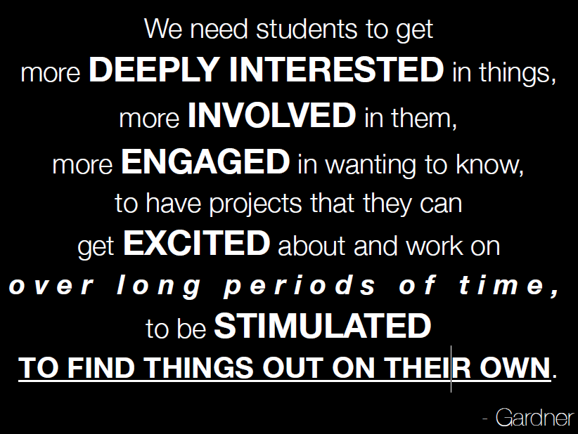

Slide 47
Bibliography
Birdsall, Peter, and Lou Correa. "Gifted Underachievers." Leadership 36th ser. Mar/Apr.4 (2007): 21-23.
Eide, Brock, and Fernette Eide. "Brains on Fire: The Multinodality of Gifted Thinkers." New Horizons for Learning. Johns Hopkins School of Education, Dec. 2004. Web. 11 Oct. 2014. <http%3A%2F%2Feducation.jhu.edu%2FPD%2Fnewhorizons%2FNeurosciences%2Farticles%2FBrains%2520on%2520Fire%2F>.
Hishinuma, Earl S. “Motivating the Gifted Underachiever: Implementing Reward Menus and Behavioral Contracts within an Integrated Approach.” Gifted Child Today. July/August (1996): 30-48.
Hoover-Schultz, Barbara. "Gifted Underachievement: Oxymoron or Educational Enigma." Gifted Child Today. 28.Spring (2005): 46-49.
Whitney, Carol Strip, and Gretchen Hirsch. Helping Gifted Children Soar: A Practical Guide for Parents and Teachers. Scottsdale, AZ: Gifted Psychology, 2000. Print.
Willis, Judy. “Challenging Gifted Middle School Students.” Principal Leadership 8th ser. Dec. 4 (2007): 38-42.

